Slide 1
Social Capital and Debt Contracting: Evidence from Bank Loans and Public Bonds
Iftekhar Hasan, Chun Keung Hoi, Qiang Wu, & Hao Zhang (2017)
Presented by Nicholas Thompson

Slide 2
Research question
How does social capital influence the cost and terms of debt financing for publicly listed corporations in the U.S.?

Slide 3
Prior literature
Social capital has positive economic benefits for societies, communities, organizations, and individuals (Fukuyama, 1995; Knack & Keefer, 1997; Putnam, 2001; Buonanno, Montolio, & Vanin, 2009).
Social capital helps overcome contractual problems because it encourages cooperation and mitigates opportunistic behaviors in transactions (Guiso, Sapienza, & Zingales, 2004, 2010).
Religious norms reduce the cost of debt (Cai & Shi, 2014; Jiang, John, Li, & Qian, 2014).
Research gap: Limited research on non-religious social capital and its effect on corporate debt.

Slide 4
Hypotheses
H1: Firms located in areas with strong cooperative norms and dense social networks incur lower loan spreads when obtaining bank loans.
H2: Firms located in areas with strong cooperative norms and dense social networks incur less stringent nonprice terms when obtaining bank loans.
H3: Firms located in areas with strong cooperative norms and dense social networks incur lower at-issue bond spreads when issuing public bonds.
H4: Firms located in areas with strong cooperative norms and dense social networks are less likely to use bank loans relative to public bonds when seeking debt financing.

Slide 5
Data
Sample: 32,425 loan-year observations for 5,678 unique firms with headquarters located in 587 unique U.S. counties in the period 1990–2012
Loan Data: DealScan
Firm Data: Compustat
County demographics: Bureau of Economic Analysis
Social Capital Data: Northeast Regional Center for Rural Development (NERCRD) at Penn State

Slide 6
SOCIAL_CAPITAL Variable
SOCIAL_CAPITAL is the first principal component from a PCA based on PVOTE, RESPN, NCCS, and ASSN.
PVOTE: Percentage of voters who voted in presidential elections.
RESPN: Response rate to the Census Bureau’s decennial census.
NCCS: Sum of tax-exempt nonprofit organizations divided by populations per 10,000.
ASSN: Sum of social organizations divided by populations per 100,000.

Slide 7
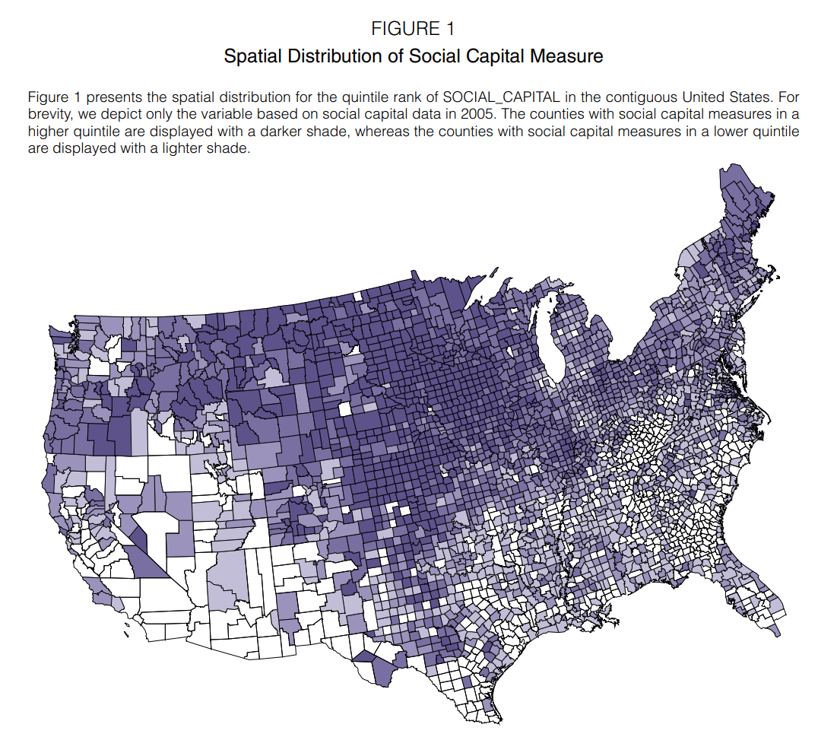
Notes:
Social capital is higher in upper Midwest/Northwest counties and lower in Southeast/Southwest counties.

Slide 8
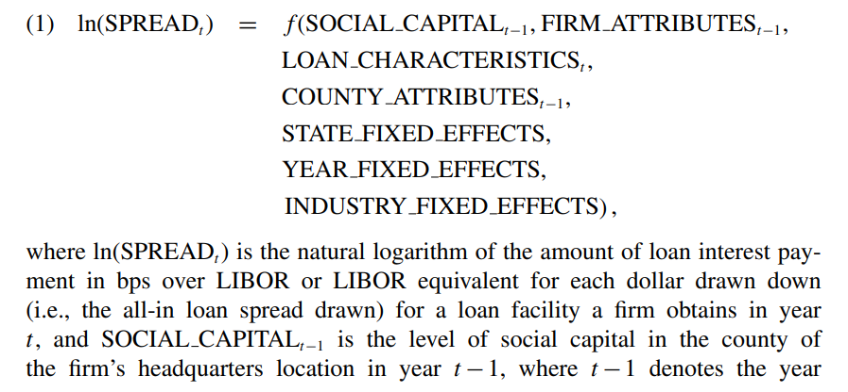

Slide 9
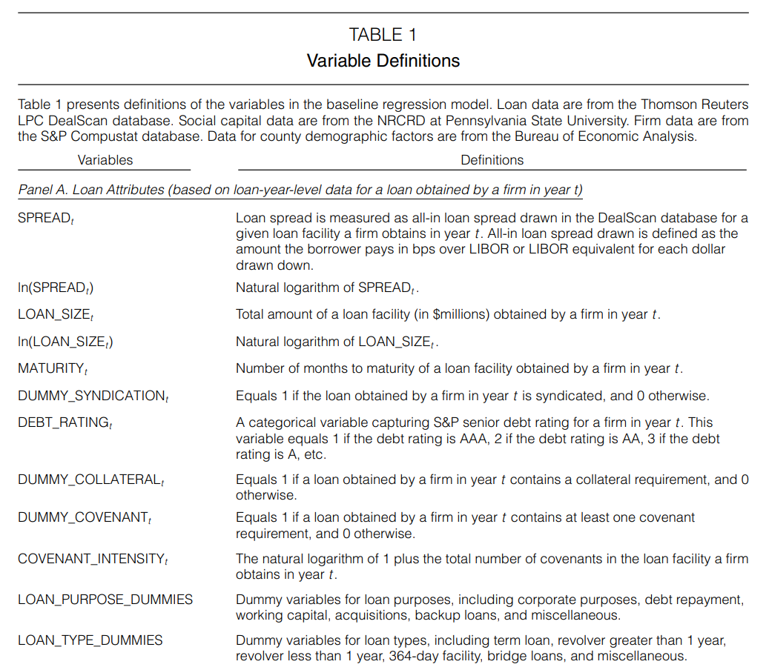
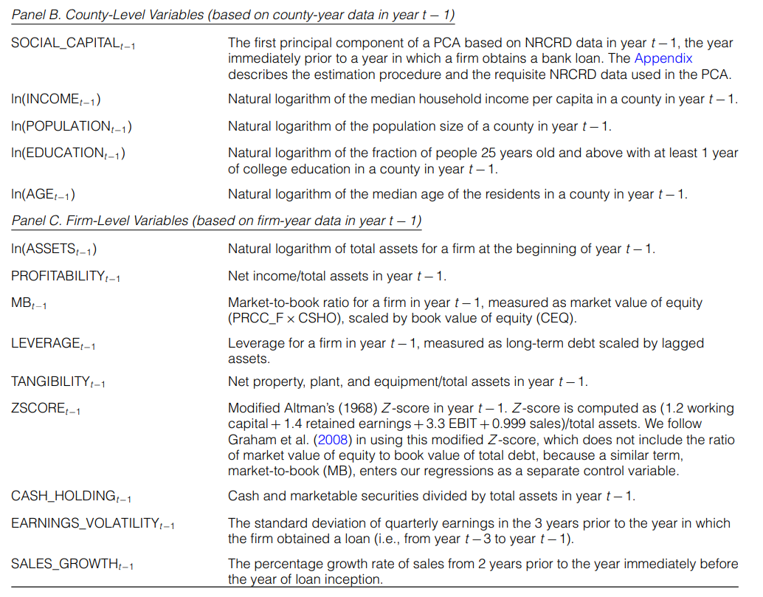

Slide 10
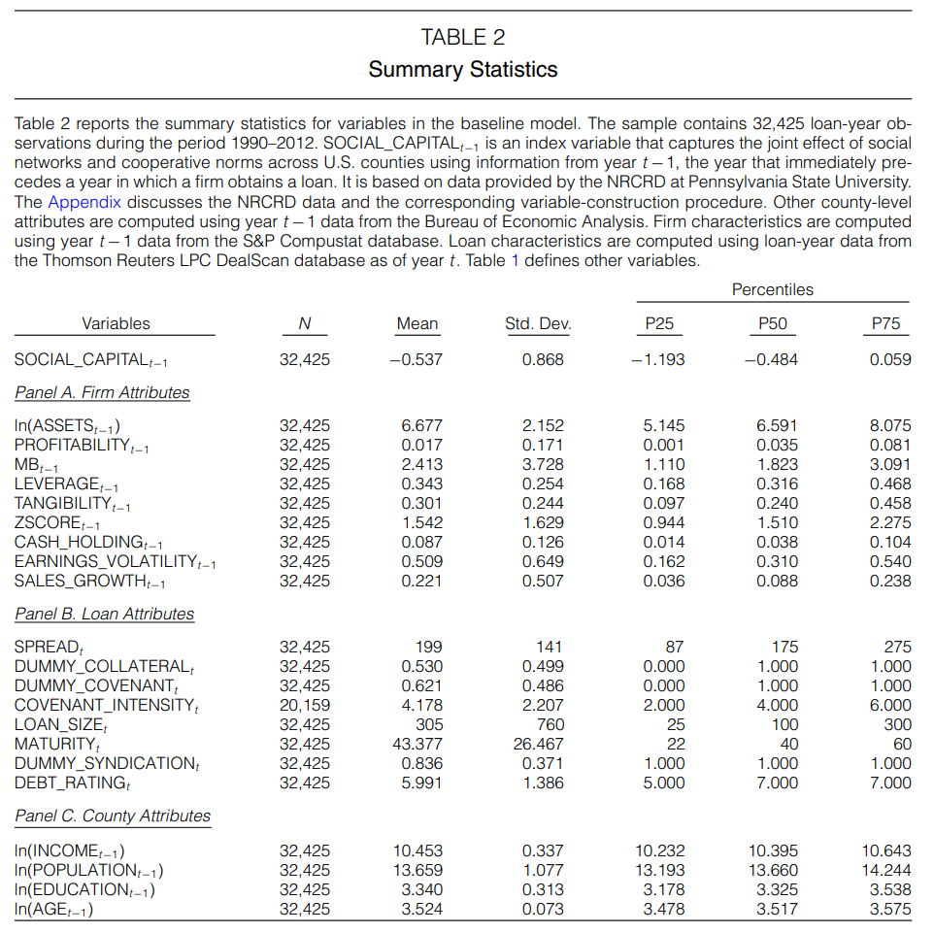
Notes:
On average, the loan spread and the loan size in our sample are 199 bps and $305 million, respectively. Approximately 53% of the sampled loan facilities have a collateral requirement. Approximately 62% of the sampled loans have at least one covenant in place; on average, these loans have around four covenants.

Slide 11
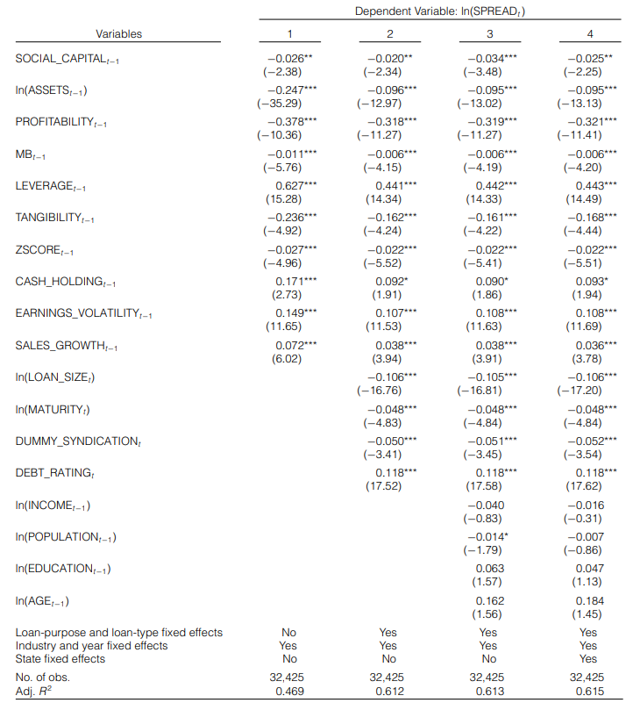
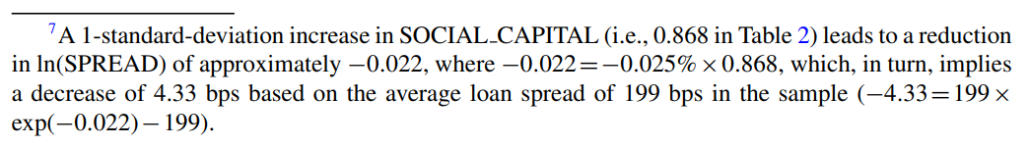
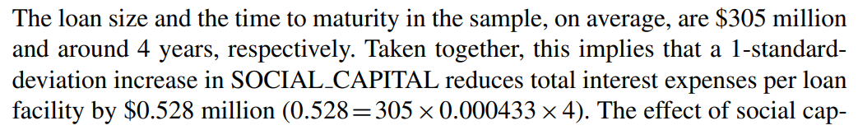
Notes:
Model 1 includes firm-level controls. Model 2 includes firm-level and loan-level controls. Model 3 contains firm-level, loan-level, and county-level controls. Model 4 is the baseline model, which includes loan-level, firm-level, and county-level controls and dummies to control for state fixed effects.

Slide 12
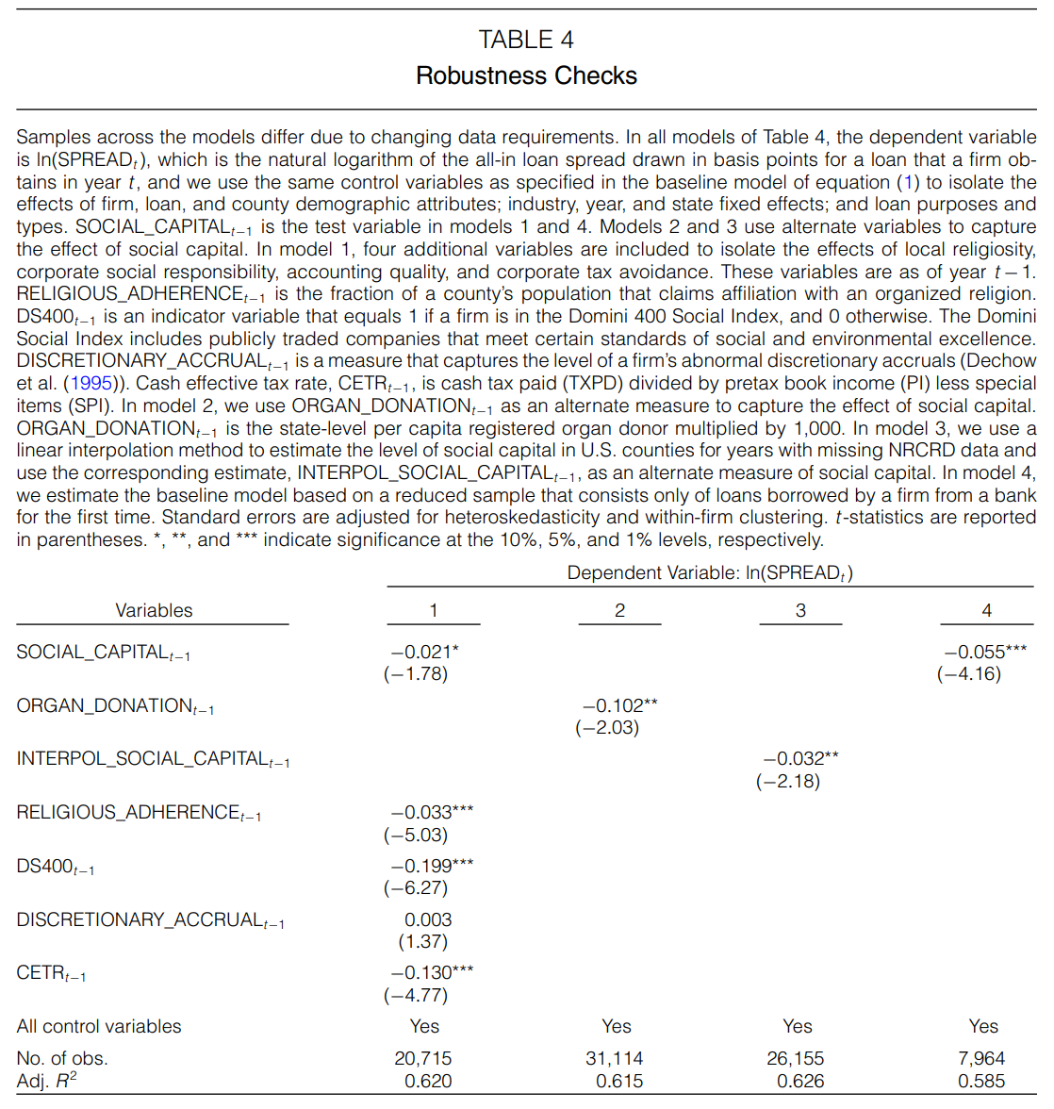
Notes:
Uses additional controls: religious adherence (local religiosity), DS400 (CSR), discretionary accruals (poor accounting quality), and CETR (inverse of corporate tax avoidance).
Uses organ donation as an alternate measure of social capital.
Uses linear interpolation to estimate missing data, rather than carrying forward values from previous years, which results in a smaller sample size.
Uses only loans borrowed by a firm from a bank for the first time, ensuring that repeated borrowing–lending relationships do not confound results.

Slide 13

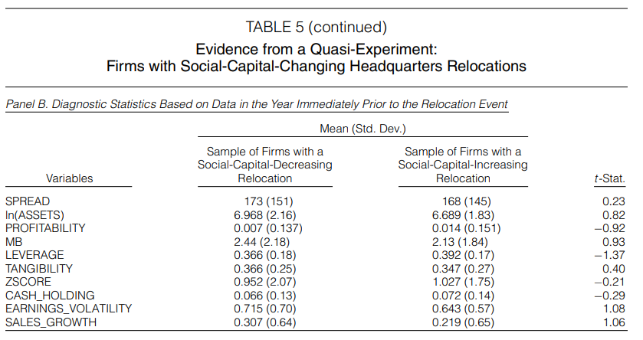
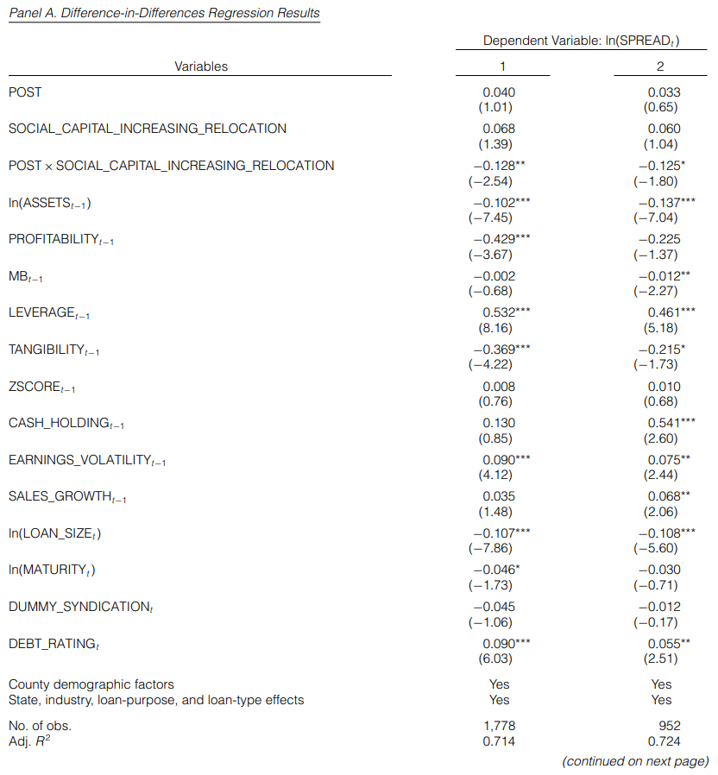
Notes:
Model 1 reports the regression results from the full sample of 1,778 firm-year observations. Model 2 limits the sample observations to a shorter event window, which defines the pre-relocation (post-relocation) period as the 4 years before (after) the relocation event.
Panel A: These results indicate that banks demand significantly lower loan spreads after the relocation event when lending to firms with social-capital-increasing relocations when compared to firms with social-capital-decreasing relocations.
Panel B: No significant differences in loan spread and firm characteristics between the two groups of firms.

Slide 14
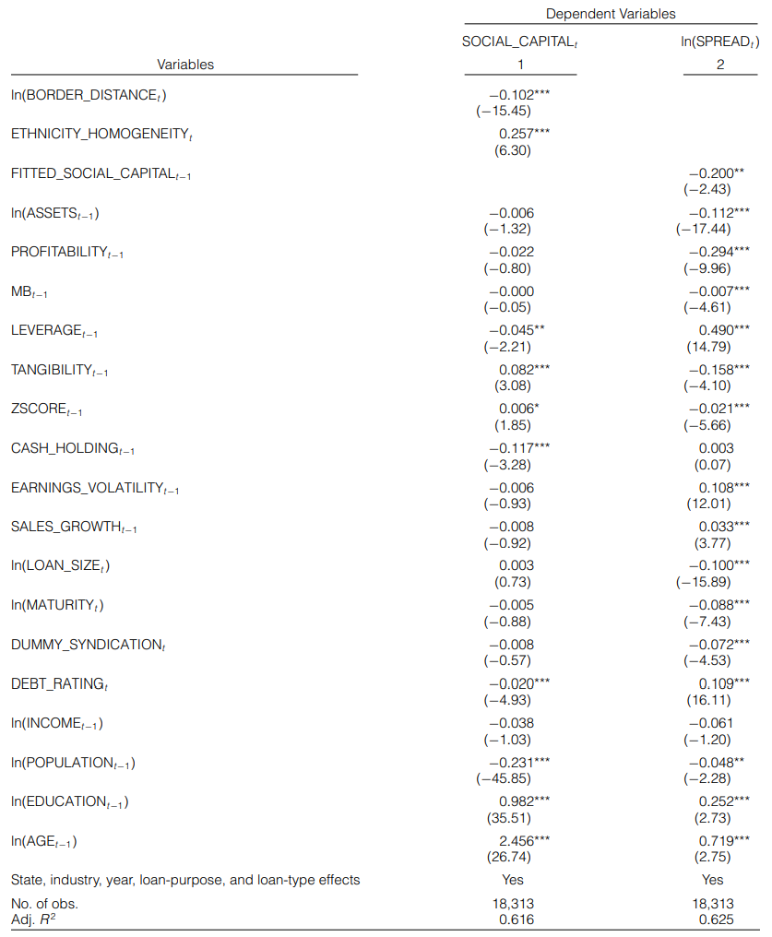
Notes:
Being closer to the Canadian border means more social capital. Ethnic homogeneity increases social capital.
A valid instrumental variable in this setting should also have no direct effect on loan spread.

Slide 15
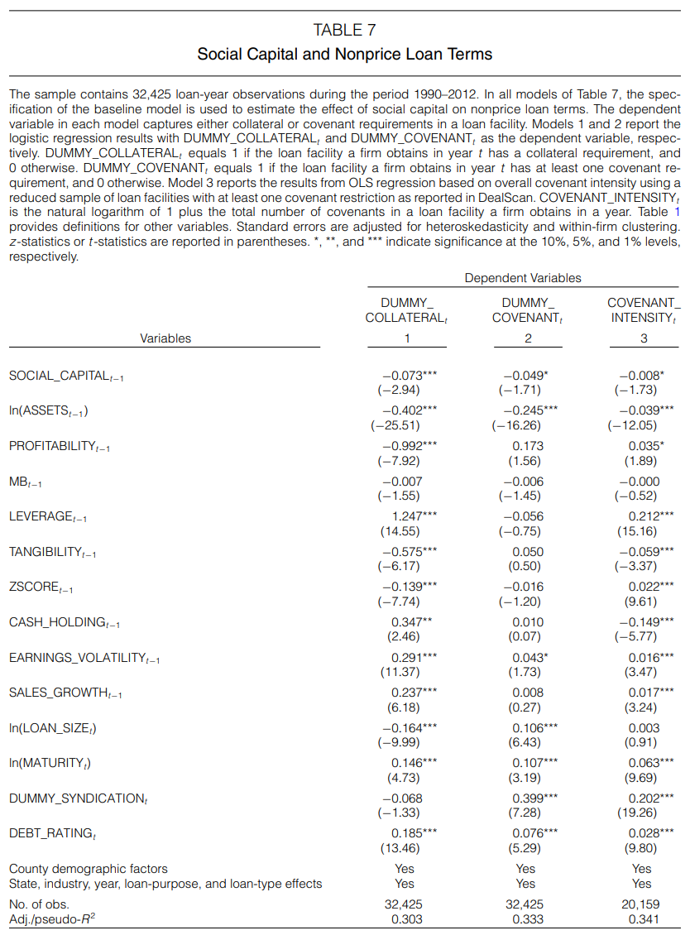

Slide 16
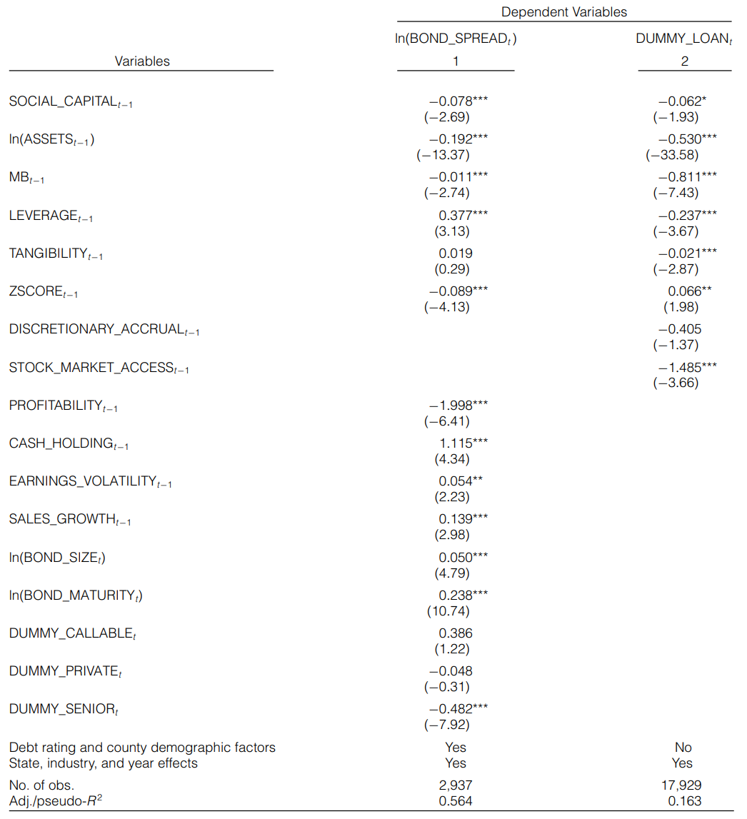
Notes:
(1) Based on this estimate, a 1-standard-deviation increase in SOCIAL CAPITAL in the data reduces at-issue bond yields by approximately 7.98 bps.
(2) We use logistic regression to predict the likelihood that firms obtain debt financing from the bank loan market rather than the public bond market.

Slide 17
Conclusion
In counties with higher levels of social capital:
Firms incur significantly lower loan spreads when obtaining debt financing from banks.
Banks demand less stringent collateral and covenant requirements.
Investors of public bonds demand significantly lower at-issue yield spreads.
Firms prefer bonds over loans when seeking debt financing.

